Slide 1

BookLand
-Developers
Rajyalakshmi Grande
Sneha Meshram
Neha Palod

Slide 2
BookLand
BookLand is an Online Book Application where the readers can Browse and Read the book online.
Through a web browser, readers can become the member of the site by simple steps for Sign-Up, can Browse the books according to their interests and Bestsellers and also, search a book by it’s Title and by Author and start reading.

Slide 3
Objectives
The main objective of “BookLand” is to provide an essence of online reading experience via a simple yet powerful medium.
The site is designed keeping a wide range of users in mind and hence the interface as well as the various procedures have been so designed that they can be used comfortably by all sorts of users.
The project has been designed to simulate the working of an actual online book store.

Slide 4
Key Features
1. There are 5000+ books available on our website where user can search books by two different categories:
-Search by Title
-Search by Author
2. User can add his favourite books in his Favourites List, therefore, our website allows users to keep a count of their favourites and relish the enjoyment of reading the same book again and again.
3. Information is displayed on latest released books and also regarding the Bestsellers.

Slide 5
Key Features
4. User can get a list of recommendations based on their interests and also, can recommend any of their favourite book to other users.
5. We have shown a complete collection of a particular book. For example, if you have searched for book “Twilight” under Search by Title category, you get complete collection of all the books related to Twilight and also, you can find the best ones in your Recommendations.
6. We gradually give notification about member’s successful registration through Email Delivery System.

Slide 6
Software Requirements
Visual Studio Code
Spring Tool Suite4
Node.js 10.16.2
MySQL 8.0
MongoDB 4.2

Slide 7
Technologies Used
Angular (Front-End Design)
Spring Boot (Back-End Design)
Mockito (Back-End Test Cases)
MySQL 8.0 (Tabular Database)
MongoDB (JSON Database)
Docker
GitLab
Karma-Jasmine (Front-End Test Cases)

Slide 8
Modules
Sign-Up
Login
Home Page (before login)
Dashboard (after login)
Search
Favourites
Recommendations
Edit Profile
Footer

Slide 9
Entity Relationship Diagram

Slide 10
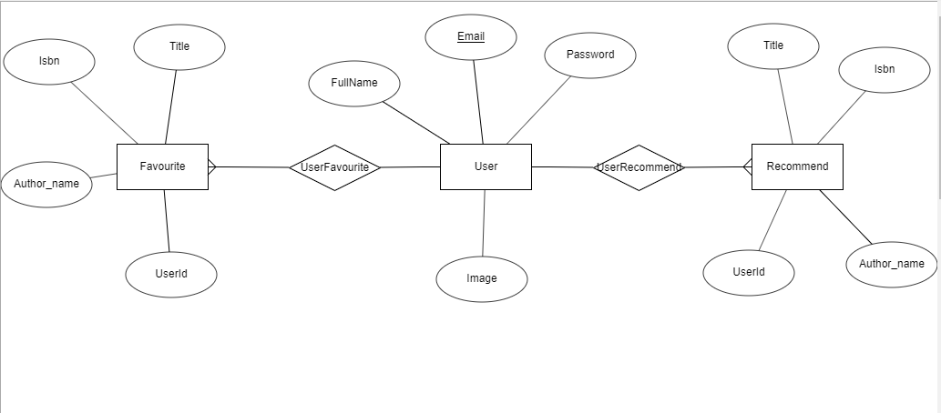

Slide 11
Screenshots

Slide 12
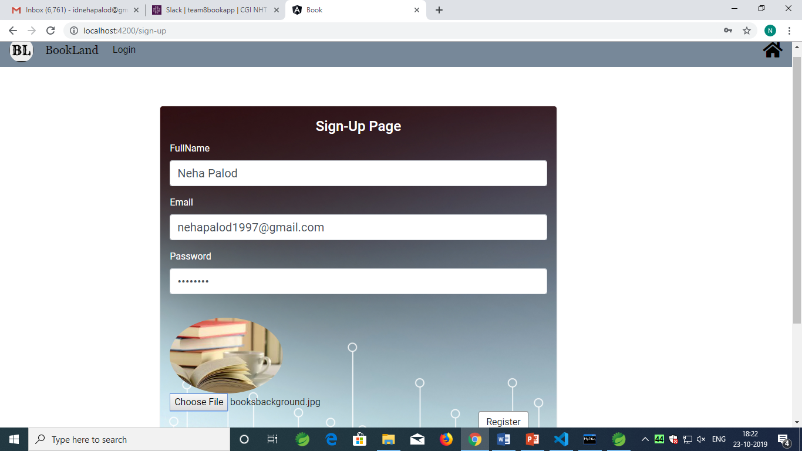
Sign-up Page

Slide 13
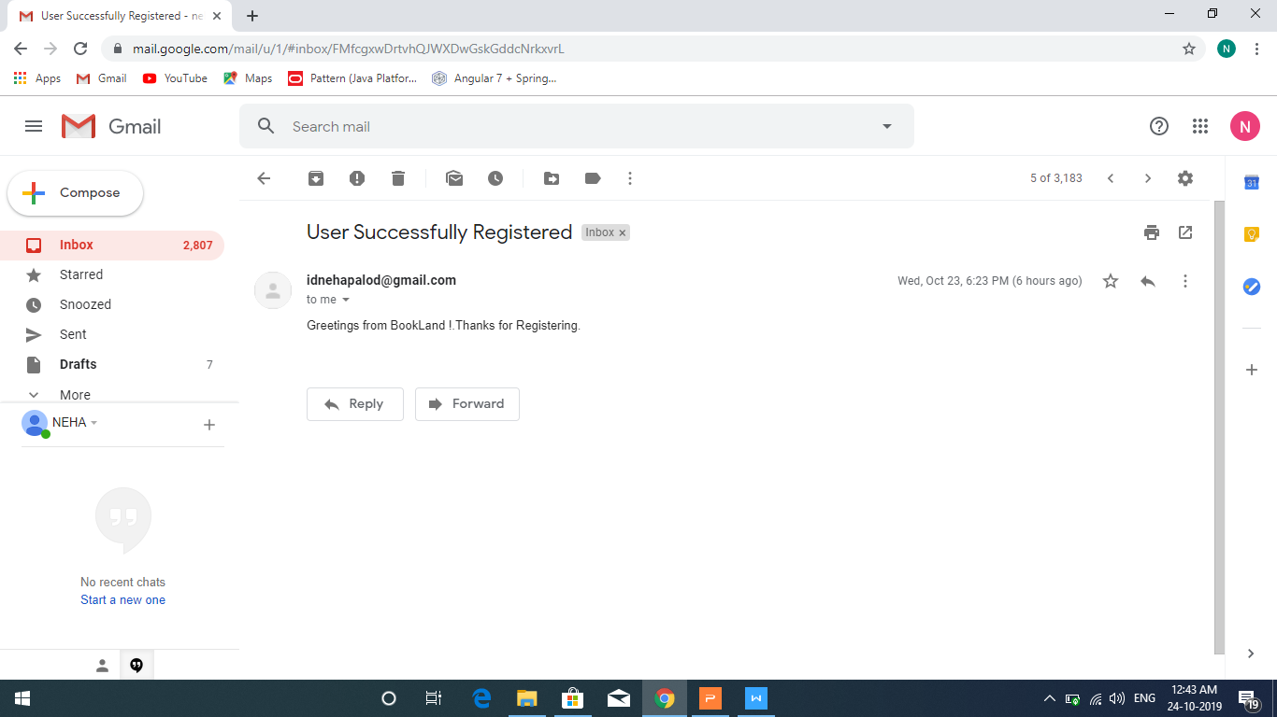
Mail Delivery System (Receiver)

Slide 14
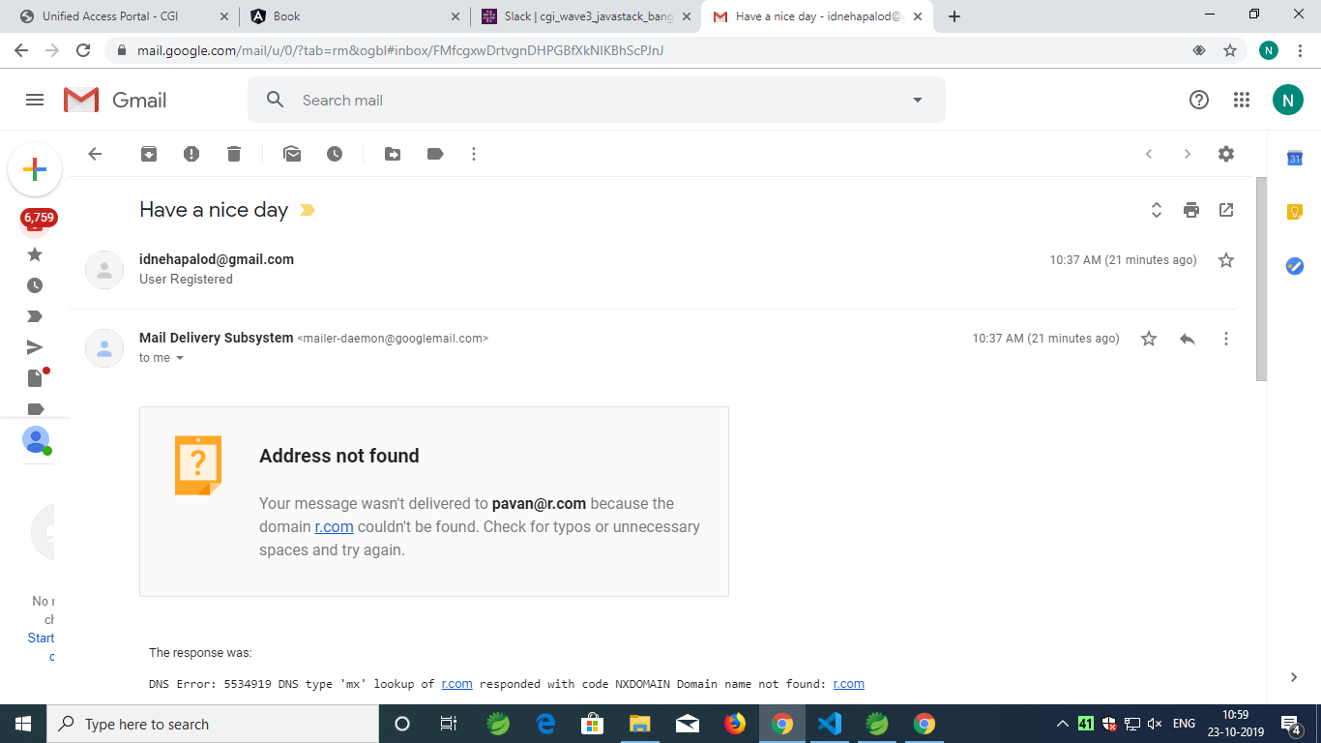
Mail Delivery System (Invalid User - Sender)

Slide 15
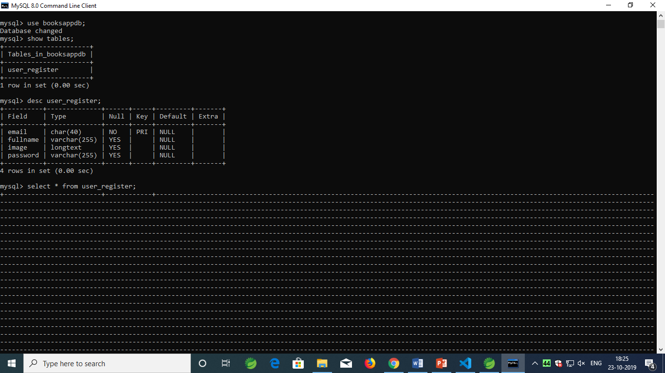
Database (MySQL)

Slide 16
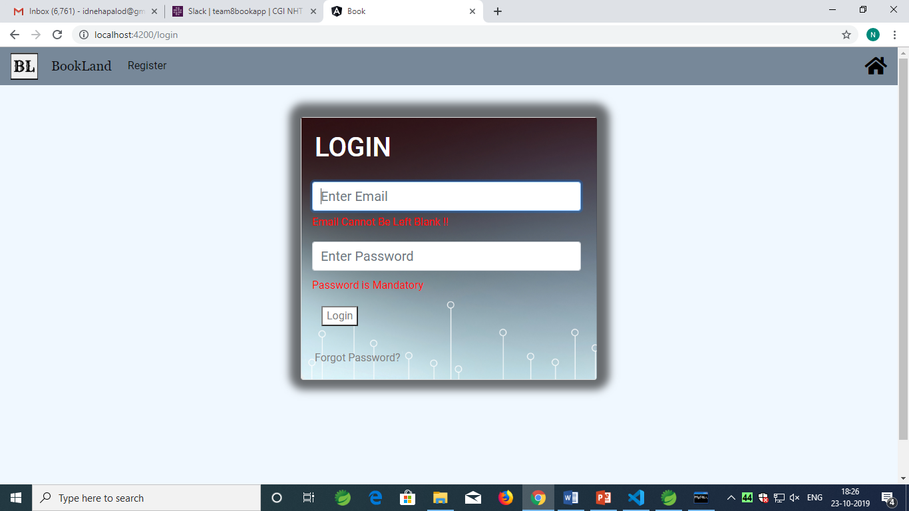
Login Page (Invalid Credentials)

Slide 17
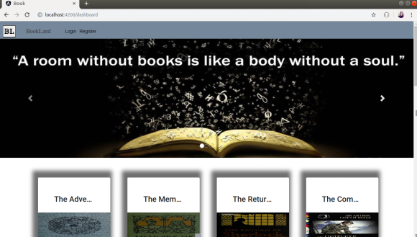
Dashboard

Slide 18
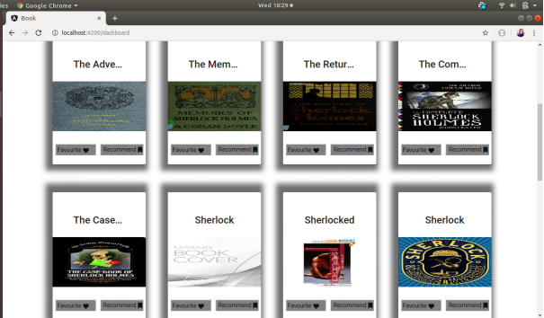
Dashboard (Default Cards)

Slide 19
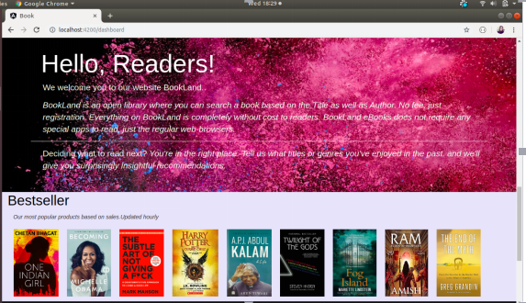
Dashboard (Information)

Slide 20
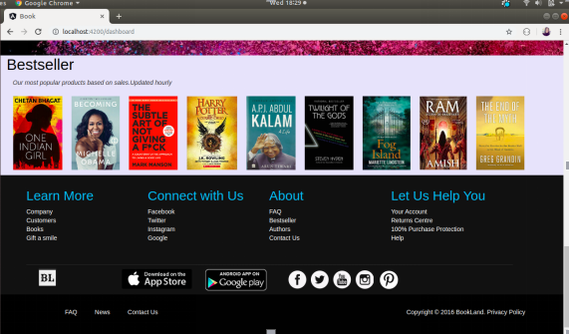
Dashboard (About Us)

Slide 21
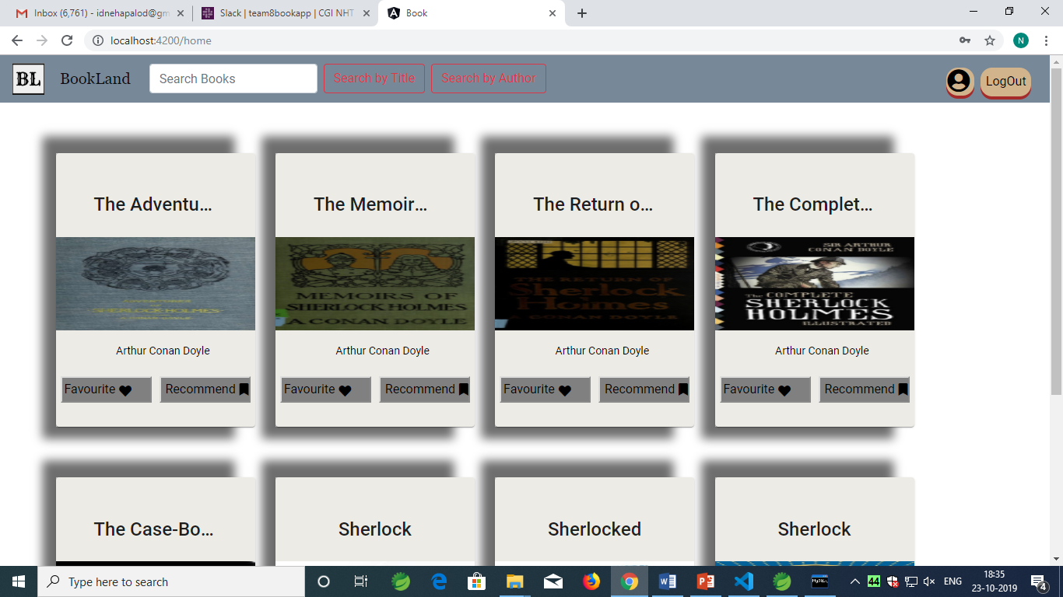
Search (Fetching Default Cards)

Slide 22
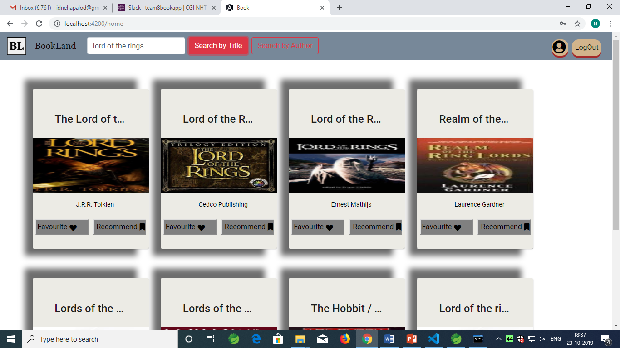
Search (Search By Title)

Slide 23
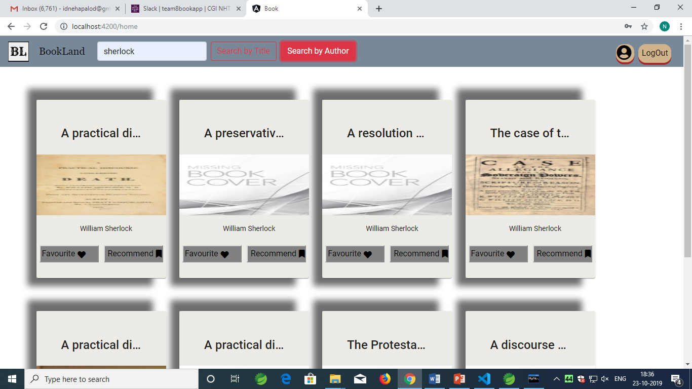
Search (Search By Author)

Slide 24
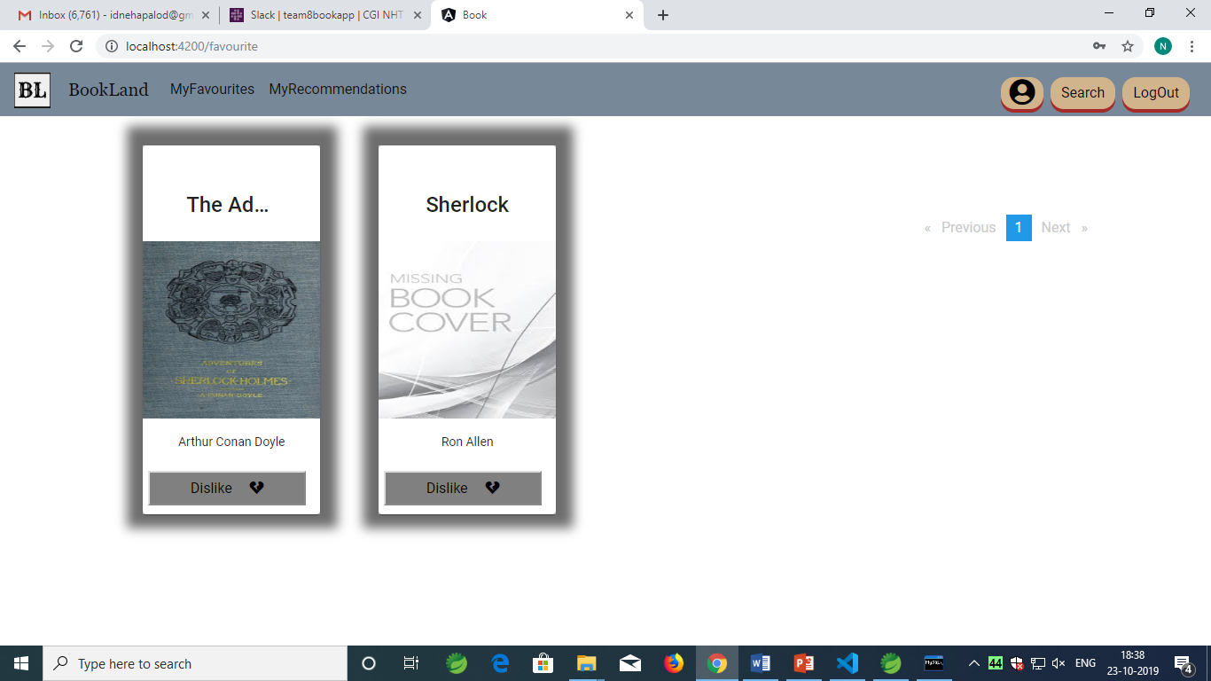
My Favourites

Slide 25
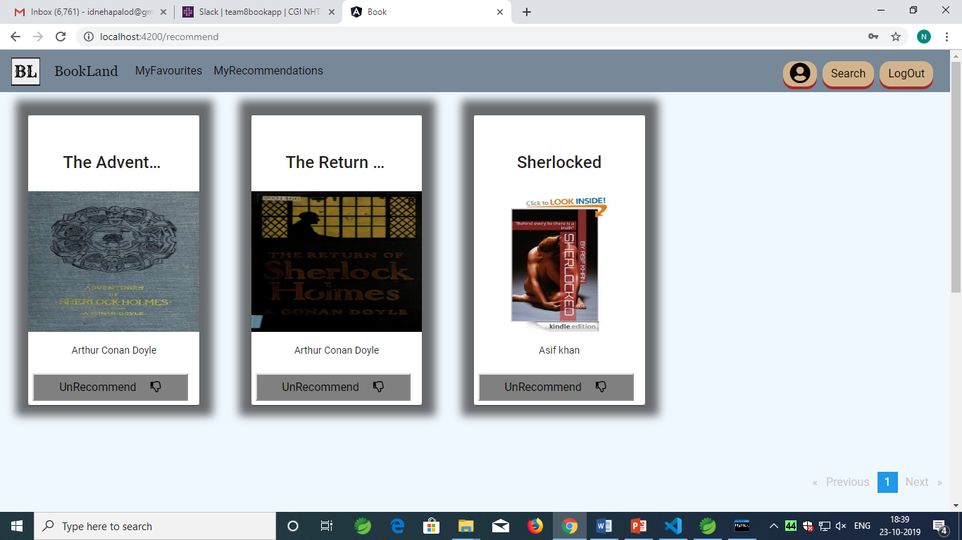
Recommendations

Slide 26
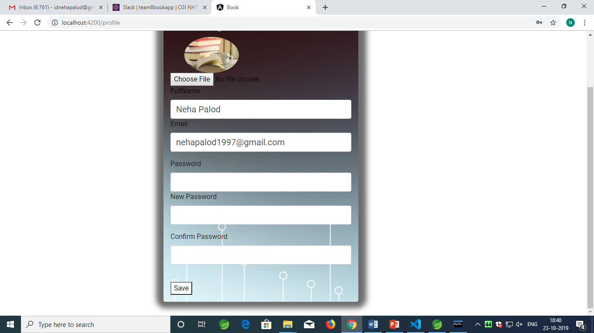
Edit Profile Page

Slide 27
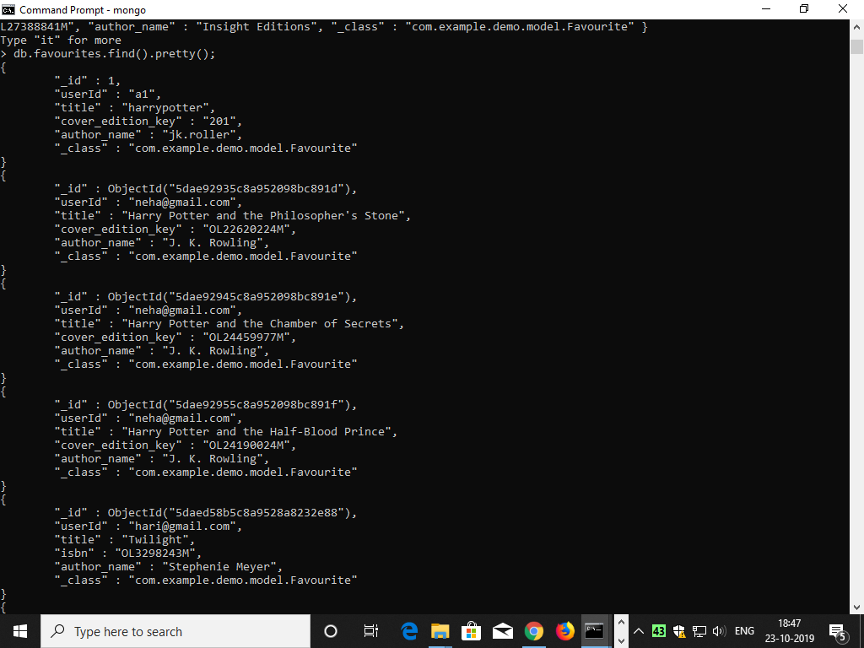
MongoDB (Favourites)

Slide 28
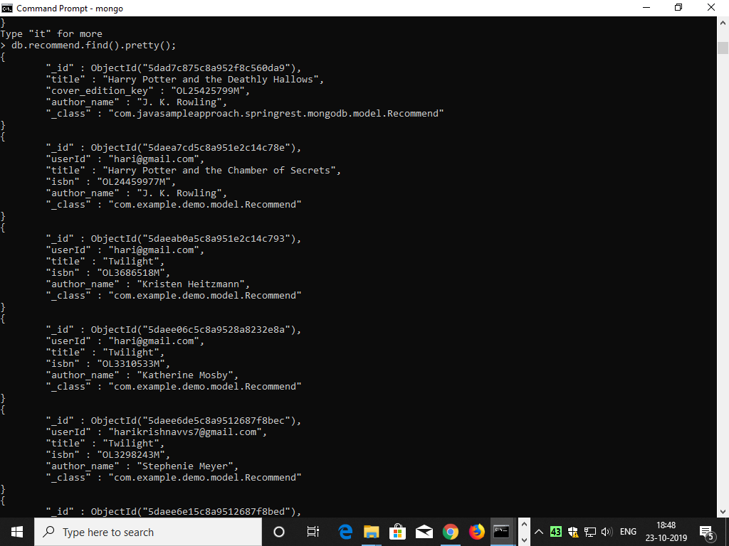
MongoDB (Recommendations)

Slide 29
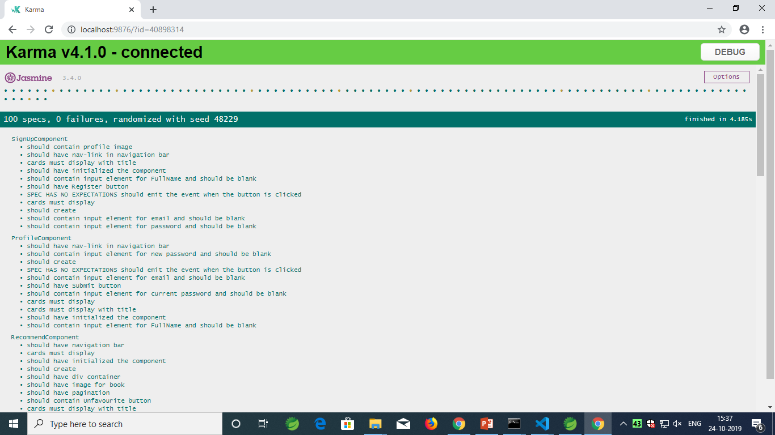
Front-End Test Cases

Slide 30
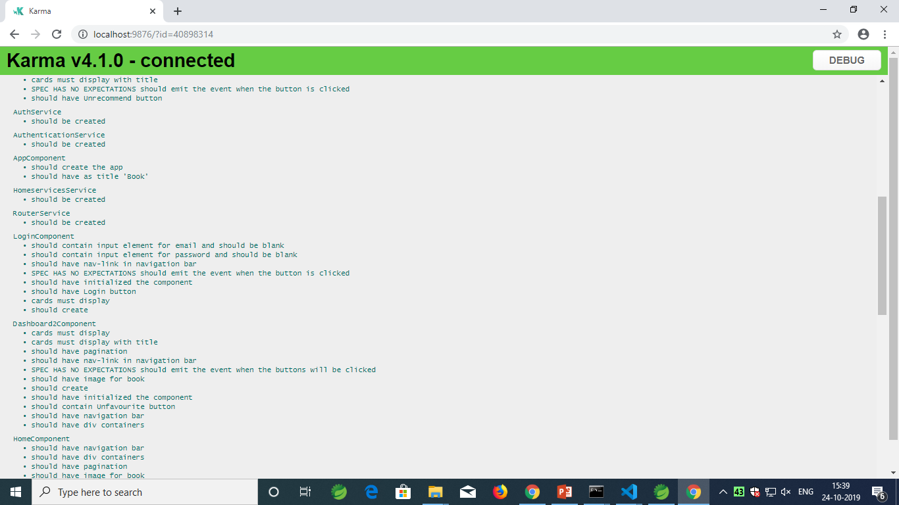
Front-End Test Cases

Slide 31
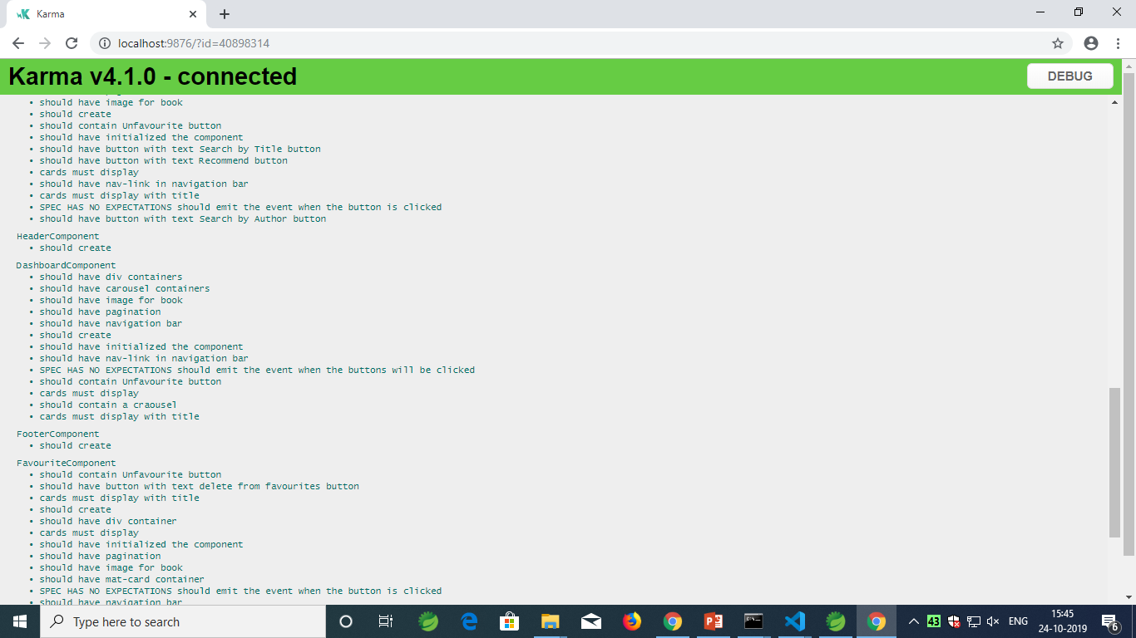
Front-End Test Cases

Slide 32
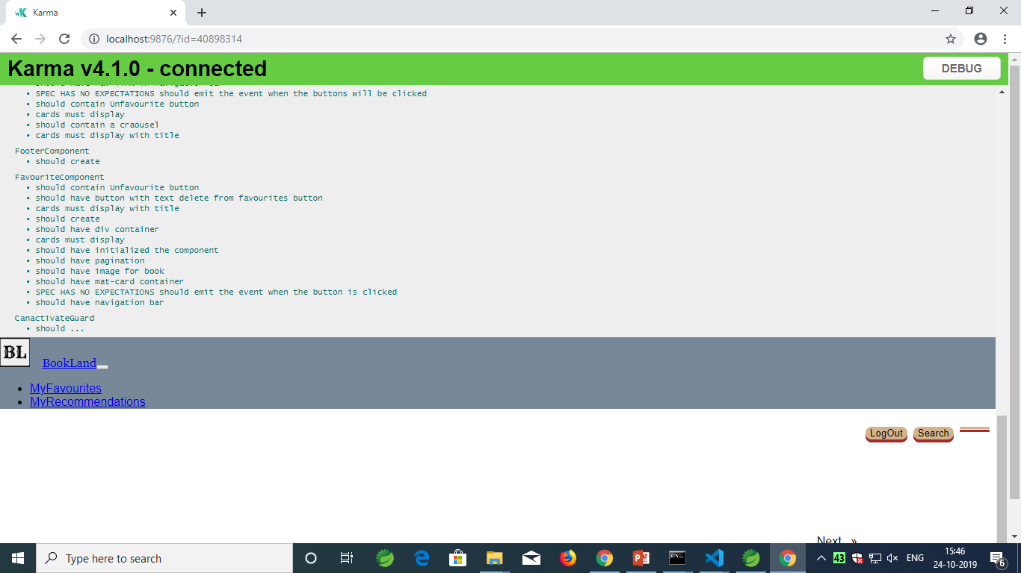
Front-End Test Cases

Slide 33
Conclusion
BookLand is an online web application where a reader can read book online. After registering to the website, a reader can search any book based on the title and author, later can add the book to the “MyFavourites” section and also, “Recommendation” section.

Slide 34
Thank You

